Slide 1
UNIT-V
Software Configuration Management
Software Configuration Management,
The SCM Repository,
The SCM process,
Configuration Management for Web and Mobile Apps
Product Metrics
Software quality, A frame work for Product metrics ,
Metric for the analysis model,
Metrics for the Design Model ,
Metrics for Source code,
Metrics for testing,
Metrics for maintenance.

Slide 2
1.Software Configuration Management
The art of coordinating software development to minimize confusion is called configuration management.
Configuration management is the art of identifying, organizing, and controlling modifications to the software being built by a programming team. The goal is to maximize productivity by minimizing mistakes.
SCM activities are developed to
(1) identify change,
(2) control change,
(3) Ensure that change is being properly implemented, and
(4) report changes to others who may have an interest.

Slide 3
The items that comprise all information produced as part of the software process are collectively called a software configuration.
There are four fundamental sources of change:
• New business or market conditions dictate changes in product requirements or business rules.
• New stakeholder needs demand modification of data produced by information systems.
• Reorganization or business growth/downsizing causes changes in project priorities or software engineering team structure.
• Budgetary or scheduling constraints cause a redefinition of the system or product.

Slide 4
1.1.1 An SCM Scenario
A typical CM operational scenario involves a
Project manager who is in charge of a software group, For the project manager, the goal is to ensure that the product is developed within a certain time frame.
A configuration manager who is in charge of the CM procedures and policies, The goals of the configuration manager are to ensure that procedures and policies for creating, changing, and testing of code are followed, as well as to make information about the project accessible
The software engineers who are responsible for developing and maintaining the software product, and the customer who uses the product, the goal is to work effectively.

Slide 5
1.1.2 Elements of a Configuration Management System
Component elements—a set of tools coupled within a file management system(e.g., a database) that enables access to and management of each software configuration item.
Process elements—a collection of actions and tasks that define an effective approach to change management (and related activities) for all constituencies involved in the management, engineering, and use of computer software.
Construction elements—a set of tools that automate the construction of
software by ensuring that the proper set of validated components (i.e., the
correct version) have been assembled.
4. Human elements—a set of tools and process features (encompassing other
CM elements) used by the software team to implement effective SCM.

Slide 6
1.1.3 Baselines
A baseline is a software configuration management concept that helps you to control change without seriously impeding justifiable change.
The IEEE defines a baseline as:
A specification or product that has been formally reviewed and agreed upon, that thereafter serves as the basis for further development, and that can be changed only through formal change control procedures.
A baseline is a milestone in the development of software. A baseline is
marked by the delivery of one or more software configuration items
that have been approved as a consequence of a technical review

Slide 7
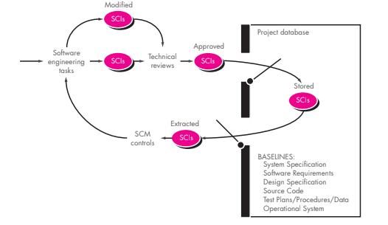


Slide 8
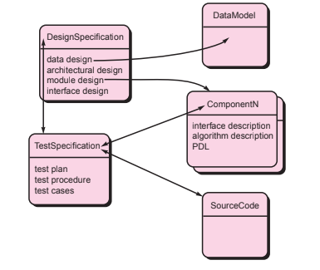

1.1.4 Software Configuration Items
SCIs are organized to form configuration objects that may be cataloged in the project database with a single name. A configuration object has a name, attributes, and is “connected” to other objects by relationships.

Slide 9
2. software configuration repository
During the early history of software engineering, the repository was indeed a person—the programmer who had to remember the location of all information relevant to a software project, who had to recall information that was never written down and reconstruct information that had been lost.
Today, the repository is a “thing”—a database that acts as the center for both accumulation and storage of software engineering information. The role of the person (the software engineer) is to interact with the repository using tools that are integrated with it.

Slide 10
2.1The Role of the Repository
The SCM repository is the set of mechanisms and data structures that allow a software team to manage change in an effective manner.
The repository is defined in terms of a meta-model.
The meta-model determines how information is stored in the repository, how data can be accessed by tools and viewed by software engineers, how well data security and integrity can be maintained, and how easily the existing model can be extended to accommodate new needs.

Slide 11
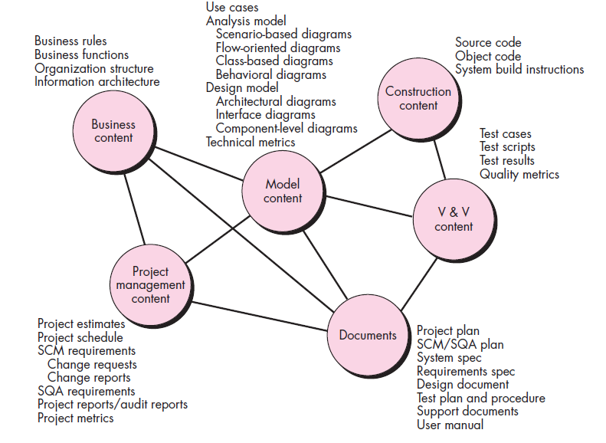

2.2 General Features and Content

Slide 12
A repository that serves a software engineering team should also
(1) integrate with or directly support process management functions,
(2) support specific rules that govern the SCM function and the data maintained within the repository,
(3) provide an interface to other software engineering tools, and
(4) accommodate storage of sophisticated data objects (e.g., text, graphics, video, audio).

Slide 13
2.3 SCM Features
Versioning. As a project progresses, many versions of individual work products will be created. The repository must be able to save all of these versions to enable effective management of product releases and to permit developers to go back to previous versions during testing and debugging.
Dependency tracking and change management. The repository manages a wide variety of relationships among the data elements stored in it. These include relationships between enterprise entities and processes, among the parts of an application design, between design components and the enterprise information architecture, between design elements and deliverables, and so on

Slide 14
Requirements tracing. This special function depends on link management and provides the ability to track all the design and construction components and deliverables that result from a specific requirements specification
Configuration management. A configuration management facility keeps track of a series of configurations representing specific project milestones or production releases.
Audit trails. An audit trail establishes additional information about when, why, and by whom changes are made.

Slide 15
3.software configuration management process
The software configuration management process defines a series of tasks that have four primary objectives:
(1) to identify all items that collectively define the software configuration,
(2) to manage changes to one or more of these items,
(3) to facilitate the construction of different versions of an application, and
(4) to ensure that software quality is maintained as the configuration evolves over time.

Slide 16
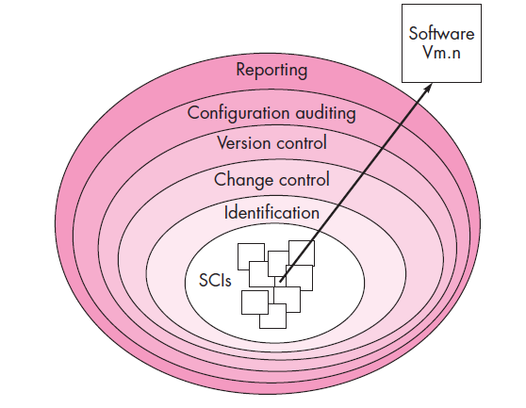

As an SCI moves through a layer, the actions implied by each SCM task may or may not be applicable. For example, when a new SCI is created, it must be identified.
However, if no changes are requested for the SCI, the change control layer does not apply. The SCI is assigned to a specific version of the software.
A record of the SCI (its name, creation date, version designation,etc.) is maintained for configuration auditing purposes and reported to those with a need to know.

Slide 17
3.1 Identification of Objects in the Software Configuration
To control and manage software configuration items, each should be separately named and then organized using an object-oriented approach.
Two types of objects can be identified:
basic objects-A basic object is a unit of information that you create during analysis, design, code, or test.
An aggregate object is a collection of basic objects and other aggregate objects

Slide 18
3.2 Version Control
Version control combines procedures and tools to manage different versions of configuration objects that are created during the software process.
A project database (repository) that stores all relevant configuration objects,
A version management capability that stores all versions of a configuration object.
A make facility that enables you to collect all relevant configuration objects and construct a specific version of the software.
In addition, version control and change control systems often implement an issues tracking (also called bug tracking) capability that enables the team to record and track the status of all outstanding issues associated with each configuration object.

Slide 19
3.3 Change Control
Change control is vital. But the forces that make it necessary also make it annoying.
We worry about change because a tiny perturbation in the code can create a big failure in the product. But it can also fix a big failure or enable wonderful new capabilities.
We worry about change because a single rogue developer could sink the project; yet brilliant ideas originate in the minds of those rogues, and a burdensome change control process could effectively discourage them from doing creative work.

Slide 20
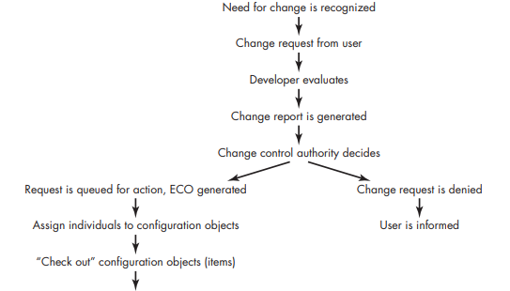
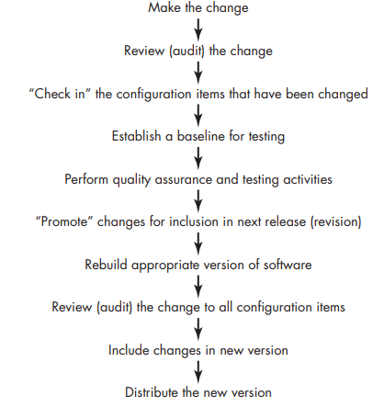

Slide 21
3.4 Configuration Audit
Identification, version control, and change control help you to maintain order in what would otherwise be a chaotic and fluid situation.
A software configuration audit complements the technical review by assessing a configuration object for characteristics that are generally not considered during review.
The audit asks and answers the following questions:
1. Has the change specified in the ECO been made? Have any additional modifications been incorporated?
2. Has a technical review been conducted to assess technical correctness?

Slide 22
3. Has the software process been followed and have software engineering standards been properly applied?
4. Has the change been “highlighted” in the SCI? Have the change date and change author been specified? Do the attributes of the configuration object reflect the change?
5. Have SCM procedures for noting the change, recording it, and reporting it been followed?
6. Have all related SCIs been properly updated?

Slide 23
3.5 Status Reporting
Configuration status reporting (sometimes called status accounting) is an SCM task that answers the following questions:
(1) What happened?
(2) Who did it?
(3) When did it happen?
(4) What else will be affected?

Slide 24
4. Configuration Management for Web and Mobile Apps
Web App developers often use an iterative, incremental process model that applies many principles derived from agile software development.
Subsequent increments add additional content and functionality, and each is likely to implement changes that lead to enhanced content, better usability, improved aesthetics, better navigation, enhanced performance, and stronger security.
Therefore, in the agile world of Web Apps, change is viewed somewhat differently.

Slide 25
4.1 Dominant Issues
Content. A typical WebApp contains a vast array of content—text, graphics, applets, scripts, audio/video files, forms, active page elements, tables, streaming data, and many others. The challenge is to organize this sea of content into a rational set of configuration objects.
People. Because a significant percentage of WebApp development continues to be conducted in an ad hoc manner, any person involved in the Web App can create content.
Scalability. The techniques and controls applied to a small WebApp do not scale upward well.

Slide 26
Politics. Who “owns” a WebApp? This question is argued in companies large and small, and its answer has a significant impact on the management and control activities.
  • Who assumes responsibility for the accuracy of the information on the website?
  • Who ensures that quality control processes have been followed before information is published to the site?
  • Who is responsible for making changes?
  • Who assumes the cost of change?

Slide 27
4.2 WebApp Configuration Objects
WebApps encompass a broad range of configuration objects—content objects ,functional components,and interface objects.
WebApp objects can be identified (assigned file names) in any manner that is appropriate for the organization.
All WebApp content has format and structure. Internal file formats are dictated by the computing environment in which the content is stored.

Slide 28
4.3 Content Management
Content management is related to configuration management in the sense that a content management system (CMS) establishes a process that acquires existing content, structures it in a way that enables it to be presented to an end user, and then provides it to the client-side environment for display.
The most common use of a content management system occurs when a dynamic WebApp is built.
The WebApp queries a database, formats the information accordingly, and presents it to the user.
CMS “configures” content for the end user by invoking three integrated subsystems: a collection subsystem, a management subsystem, and a publishing subsystem

Slide 29
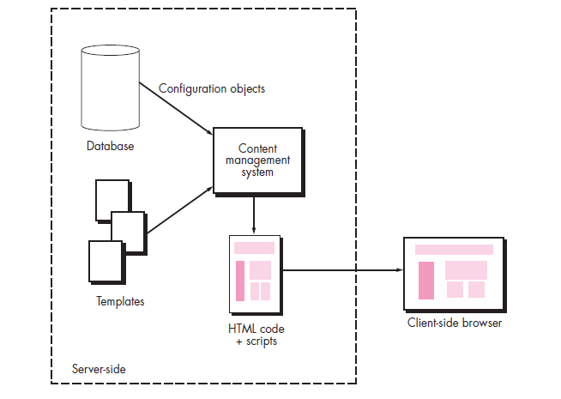

Slide 30
4.4 Change Management
To implement effective change management within the “code and go” philosophy that continues to dominate WebApp development, the conventional change control process must be modified. Each change should be categorized into one of four classes:
Class 1— a content or function change that corrects an error or enhances local content or functionality
Class 2—a content or function change that has an impact on other content objects or functional components
Class 3—a content or function change that has a broad impact across a WebApp
Class 4—a major design change that will be immediately noticeable to one or more categories of user

Slide 31
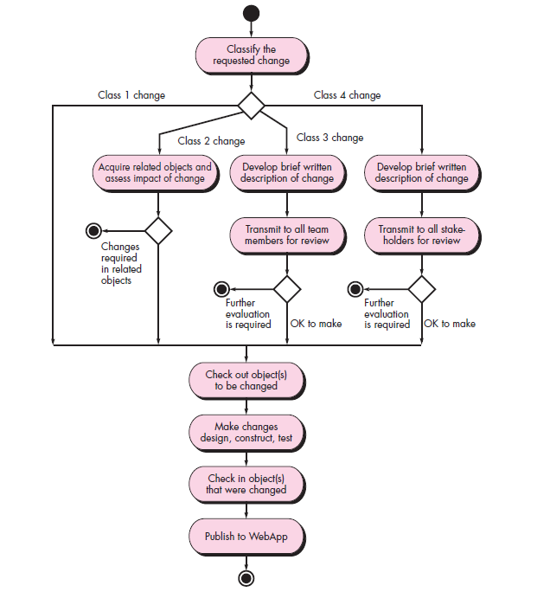

Slide 32
4.5 Version Control
As a WebApp evolves through a series of increments, a number of different versions may exist at the same time.
One version (the current operational WebApp) is available via the Internet for end users;
another version (the next WebApp increment) may be in the final stages of testing prior to deployment;
a third version is in development and represents a major update in content, interface aesthetics, and functionality. Configuration objects must be clearly defined so that each can be associated with the appropriate version.

Slide 33
A version control process is required.
A central repository for the WebApp project should be established.
2. Each Web engineer creates his or her own working folder.
3.The clocks on all developer workstations should be synchronized.
4. As new configuration objects are developed or existing objects are changed, they are imported into the central repository.
5. As objects are imported or exported from the repository, an automatic, timestamped log message is made.

Slide 34
4.6 Auditing and Reporting
In the interest of agility, the auditing and reporting functions are deemphasized in Web engineering work.
All objects that are checked into or out of the repository are recorded in a log that can be reviewed at any point in time.
A complete log report can be created so that all members of the WebApp team have a chronology of changes over a defined period of time.
In addition, an automated e-mail notification (can be sent every time an object is checked in or out of the repository.

Slide 35
5. A Framework for product metrics
5.1 Measures, Metrics, and Indicators
A measure provides a quantitative indication of the extent, amount, dimension, capacity, or size of some attribute of a product or process.
The IEEE Standard Glossary of Software Engineering Terminology [IEE93b] defines metric as “a quantitative measure of the degree to which a system, component, or process possesses a given attribute.”
An indicator is a metric or combination of metrics that provides insight into the software process, a software project, or the product itself. An indicator provides insight that enables the project manager or software engineers to adjust the process, the project, or the product to make things better.

Slide 36
5.2 The Challenge of Product Metrics
Measurement is essential if quality is to be achieved.
Over the past four decades, many researchers have attempted to develop a single metric that provides a comprehensive measure of software complexity.
Fenton characterizes this research as a search for “the impossible holy grail.”
In spite of the intuitive connections between the internal structure of software products [product metrics] and its external product and process attributes, there have actually been very few scientific attempts to establish specific relationships.
There are a number of reasons why this is so; the most commonly cited is the impracticality of conducting relevant experiments.

Slide 37
5.3 Measurement Principles
Measurement process that can be characterized by five activities
Formulation. The derivation of software measures and metrics appropriate for the representation of the software that is being considered.
• Collection. The mechanism used to accumulate data required to derive the formulated metrics.
• Analysis. The computation of metrics and the application of mathematical tools.
• Interpretation. The evaluation of metrics resulting in insight into the quality of the representation.
• Feedback. Recommendations derived from the interpretation of product metrics transmitted to the software team

Slide 38
Principles
A metric should have desirable mathematical properties.
• When a metric represents a software characteristic that increases when positive traits occur or decreases when undesirable traits are encountered, the value of the metric should increase or decrease in the same manner.
• Each metric should be validated empirically in a wide variety of contexts before being published or used to make decisions.

Slide 39
5.4 Goal-Oriented Software Measurement
The Goal/Question/Metric (GQM) paradigm has been developed by Basili and Weiss [Bas84] as a technique for identifying meaningful metrics for any part of the software process.
GQM emphasizes the need to
Establish an explicit measurement goal that is specific to the process activity or product characteristic that is to be assessed
Define a set of questions that must be answered in order to achieve the goal, and
Identify well-formulated metrics that help to answer these questions. A goal definition template [Bas94] can be used to define each measurement goal.

Slide 40
The template takes the form:
Analyze {the name of activity or attribute to be measured} for the purpose of {the overall objective of the analysis2 } with respect to {the aspect of the activity or attribute that is considered} from the viewpoint of {the people who have an interest in the measurement} in the context of {the environment in which the measurement takes place}.
As an example, consider a goal definition template for Safe Home: Analyze the Safe Home software architecture for the purpose of evaluating architectural components with respect to the ability to make Safe Home more extensible from the viewpoint of the software engineers performing the work in the context of product enhancement over the next three years.

Slide 41
5.5 The Attributes of Effective Software Metrics
Simple and computable.
• Empirically and intuitively persuasive.
• Consistent and objective.
• Consistent in its use of units and dimensions.
• Programming language independent.
• An effective mechanism for high-quality feedback.

Slide 42
6.Metrics for the requirements model
6.1 Function-Based Metrics
The function point (FP) metric can be used effectively as a means for
measuring the functionality delivered by a system.
Using historical data, the FP metric can then be used to
Estimate the cost or effort required to design, code, and test the software;
Predict the number of errors that will be encountered during testing; and
Forecast the number of components and/or the number of projected source lines in the implemented system

Slide 43
Function points are derived using an empirical relationship based on countable (direct) measures of software’s information domain and qualitative assessments of software complexity.
      Number of external inputs (EIs).
      Number of external outputs (EOs).
      Number of external inquiries (EQs).
      Number of internal logical files (ILFs).
      Number of external interface files (EIFs).

Slide 44
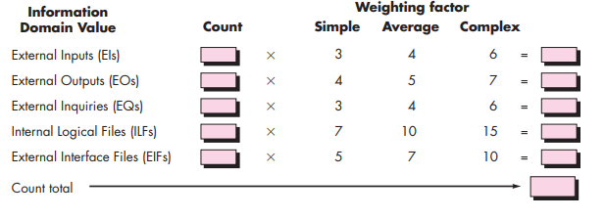
Computing function points

Slide 45
6.2 Metrics for Specification Quality
List of characteristics that can be used to assess the quality of the requirements model and the corresponding requirements specification:
  specificity (lack of ambiguity),
  completeness,
  correctness,
  understandability,
  verifiability,
  internal and external consistency,
  achievability,
  concision,
  traceability,
  modifiability,
  precision, and
  reusability.

Slide 46



nr = nf + nnf
where nf is the number of functional requirements and nnf is the number of nonfunctional (e.g., performance) requirements.
Q1 = nui/ nr
where nui is the number of requirements for which all reviewers had identical interpretations. The closer the value of Q to 1, the lower is the ambiguity of the specification
where nc is the number of requirements that have been validated as correct and nnv is the number of requirements that have not yet been validated

Slide 47
7.Metrics for the Design Model
7.1 Architectural Design Metrics
Architectural design metrics focus on characteristics of the program architecture with an emphasis on the architectural structure and the effectiveness of modules or components within the architecture.
These metrics are “black box” in the sense that they do not require any knowledge of the inner workings of a particular software component.
Card and Glass define three software design complexity measures: structural complexity, data complexity, and system complexity

Slide 48



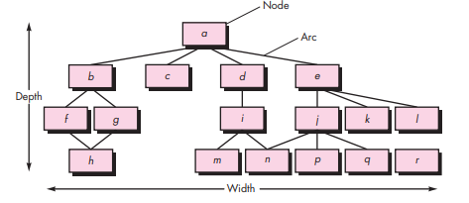
Morphology metrics

Slide 49
7.2 Metrics for Object-Oriented Design
Size-Size is defined in terms of four views: population, volume, length, and functionality
Complexity.
Sufficiency.
Coupling
Completeness.
Cohesion
Primitiveness.
Similarity
Volatility

Slide 50
7.3 Class-Oriented Metrics—The CK Metrics Suite
The class is the fundamental unit of an OO system.
A class encapsulates data and the function that manipulate the data. It is often the “parent” for subclasses (sometimes called children) that inherit its attributes and operations.
It often collaborates with other classes.
Each of these characteristics can be used as the basis for measurement

Slide 51
six class-based design metrics for OO systems.
Weighted methods per class (WMC) as the number of methods grows for a given class, it is likely to become more and more application specific, thereby limiting potential reuse, WMC should be kept as low as is reasonable
Depth of the inheritance tree (DIT). This metric is “the maximum length from the node to the root of the tree”.
Number of children (NOC).

Slide 52
Coupling between object classes (CBO).
Response for a class (RFC). The response set of a class is “a set of methods that can potentially be executed in response to a message received by an object of that class”.
Lack of cohesion in methods (LCOM). Each method within a class C accesses one or more attributes (also called instance variables). LCOM is the number of methods that access one or more of the same attributes.

Slide 53
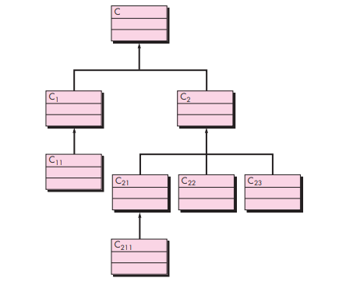
A class hierarchy

Slide 54
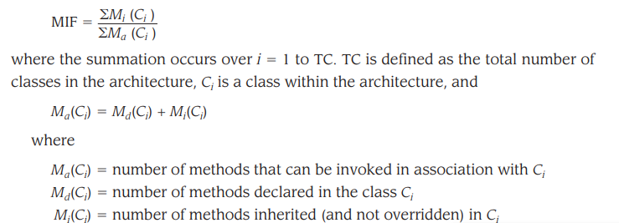
7.4 Class-Oriented Metrics—The MOOD Metrics Suite
Method inheritance factor (MIF). The degree to which the class architecture of an OO system makes use of inheritance for both methods (operations) and attributes is defined as

Slide 55
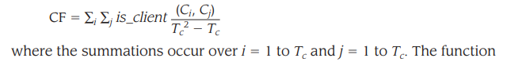

Coupling factor (CF). coupling is an indication of the connections between elements of the OO design. The MOOD metrics suite defines coupling in the following way:

Slide 56
7.5 OO Metrics Proposed by Lorenz and Kidd
class-based metrics into four broad categories that each have a bearing on component-level design:
Size-oriented metrics for an OO design class focus on counts of attributes and operations for an individual class and average values for the OO system as a whole.
Inheritance-based metrics focus on the manner in which operations are reused through the class hierarchy.
Metrics for class internals look at cohesion and code-oriented issues, and
external metrics examine coupling and reuse.

Slide 57
7.6 Component-Level Design Metrics
Component-level design metrics for conventional software components focus on internal characteristics of a software component and include measures
Cohesion metrics
Data slice -is a backward walk through a module that looks for data values that affect the module location at which the walk began. It should be noted that both program slices (which focus on statements and conditions) and data slices can be defined.
Data tokens. The variables defined for a module can be defined as data tokens for the module.
Glue tokens. This set of data tokens lies on one or more data slice.
Superglue tokens. These data tokens are common to every data slice in a module.
Stickiness. The relative stickiness of a glue token is directly proportional to the number of data slices that it binds

Slide 58
2.Coupling metrics
Module coupling provides an indication of the “connectedness” of a module to other modules, global data, and the outside environment
For data and control flow coupling,
di number of input data parameters
ci number of input control parameters do number of output data parameters
co number of output control parameters
For global coupling,
gd number of global variables used as data
gc number of global variables used as control

Slide 59

For environmental coupling,
W number of modules called (fan-out)
r number of modules calling the module under consideration (fan-in) ,
module coupling indicator mc
where k is a proportionality constant

Slide 60
3.Complexity metrics
Complexity metrics can be used to predict critical information about reliability and maintainability of software systems from automatic analysis of source code [or procedural design information].
Complexity metrics also provide feedback during the software project to help control the [design activity].
During testing and maintenance, they provide detailed information about software modules to help pinpoint areas of potential instability.
The most widely used complexity metric for computer software is cyclomatic complexity, originally developed by Thomas McCabe

Slide 61
7.7 Operation-Oriented Metrics
Average operation size . Size can be determined by counting the number of lines of code or the number of messages sent by the operation. As the number of messages sent by a single operation increases, it is likely that responsibilities have not been well allocated within a class.
Operation complexity (OC). The complexity of an operation can be computed using any of the complexity metrics proposed for conventional software. Because operations should be limited to a specific responsibility, the designer should strive to keep OC as low as possible.
Average number of parameters per operation. The larger the number of operation parameters, the more complex the collaboration between objects.,should be kept as low as possible.

Slide 62
7.8 User Interface Design Metrics
A typical GUI uses layout entities—graphic icons, text, menus, windows, and the like—to assist the user in completing tasks. To accomplish a given task using a GUI, the user must move from one layout entity to the next.
The absolute and relative position of each layout entity, the frequency with which it is used, and the “cost” of the transition from one layout entity to the next all contribute to the appropriateness of the interface
The number of words, links, graphics, colors, and fonts contained within a Web page affect the perceived complexity and quality of that page.

Slide 63
8.Metrics for Source code
Measures to develop expressions for the
overall program length,
potential minimum volume for an algorithm,
the actual volume (number of bits required to specify a program),
the program level (a measure of software complexity),
the language level (a constant for a given language), and
other features such as development effort, development time, and even the projected number of faults in the software.
The measures are
    n1 number of distinct operators that appear in a program
    n2 number of distinct operands that appear in a program
    N1 total number of operator occurrences
    N2 total number of operand occurrences

Slide 64



length N can be estimated
program volume may be defined
volume ratio L as the ratio of volume of the most compact form of a program to the volume of the actual program. In actuality, L must always be less than 1. In terms of primitive measures, the volume ratio may be expressed as

Slide 65
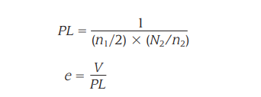
9.Metrics for Testing
The majority of metrics proposed focus on the process of testing, not the technical characteristics of the tests themselves.
In general, testers must rely on analysis, design, and code metrics to guide them in the design and execution of test cases.
9.1 Halstead Metrics Applied to Testing
Using the definitions for program volume V and program level PL, Halstead effort e can be computed as

Slide 66

The percentage of overall testing effort to be allocated to a module k can be estimated using the following relationship

Slide 67
9.2 Metrics for Object-Oriented Testing
Lack of cohesion in methods (LCOM).
Percent public and protected (PAP)
Public access to data members (PAD)
Number of root classes (NOR)
Fan-in (FIN)
Number of children (NOC) and depth of the inheritance tree (DIT)

Slide 68
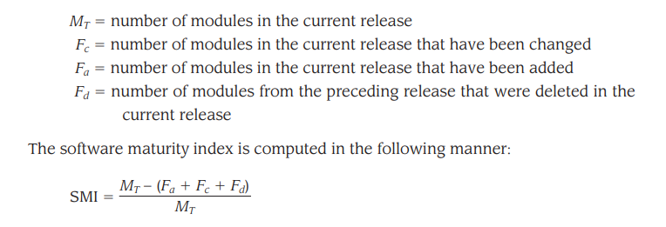
10. Metrics for maintenance
software maturity index (SMI) that provides an indication of the stability of a software product (based on changes that occur for each release of the product).

Slide 69
Testing scenarios

Slide 70
Test case Examples
A test case contains:
  A sequence of Steps describing actions to be performed,
  Test data to be used
  An expected response for each action performed.
Test Cases are written based on Business and Functional/Technical requirements, use cases and Technical design documents.
There can be 1:1 or 1:N or N:1 or N:N relationship between requirements and Test cases
The level of details specified in test cases will vary depending on Organizations, Projects and also on the Test Case Template used OR on the Test Management tool being used in the project.

Slide 71
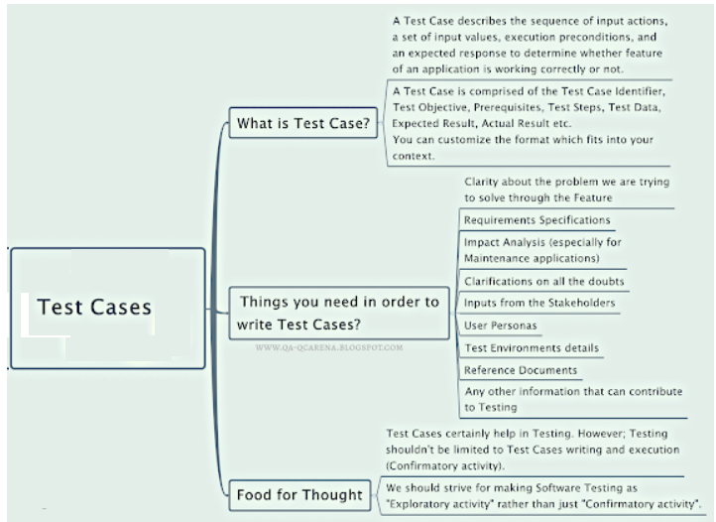

Slide 72
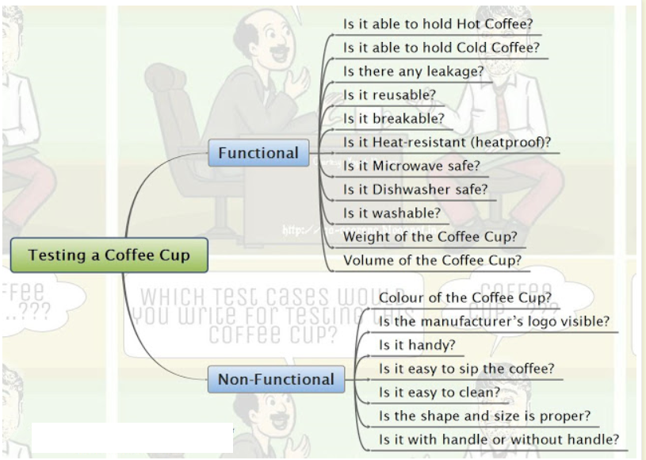
How do you Test a Coffee Cup ?

Slide 73
Test case for ATM
  TC 1 :- successful card insertion.
  TC 2 :- unsuccessful operation due to wrong angle card insertion.
  TC 3:- unsuccessful operation due to invalid account card.
  TC 4:- successful entry of pin number.
  TC 5:- unsuccessful operation due to wrong pin number entered 3 times.
  TC 6:- successful selection of language.
  TC 7:- successful selection of account type.
  TC 8:- unsuccessful operation due to wrong account type selected w/r to that inserted card.
  TC 9:- successful selection of withdrawal option.
  TC 10:- successful selection of amount.
  TC 11:- unsuccessful operation due to wrong denominations.
  TC 12:- successful withdrawal operation.
  TC 13:- unsuccessful withdrawal operation due to amount greater than possible balance.
  TC 14:- saucerful due to lack of amount in ATM.
  TC 15:- un due to amount greater than the day limit.
  TC 16:- un due to server down.
  TC 17:- un due to click cancel after insert card.
  TC 18:- un due to click cancel after insert card and pin no.

Slide 74
Test cases for a web page
  Testing without entering any username and password
  Test it only with Username
  Test it only with password.
  User name with wrong password
  Password with wrong user name
  Right username and right password
  Cancel, after entering username and password.
  Enter long username and password that exceeds the set limit of characters.
  Try copy/paste in the password text box.
  After successful sign-out, try “Back” option from your browser. Check whether it gets you to the “signed-in” page.

Slide 75
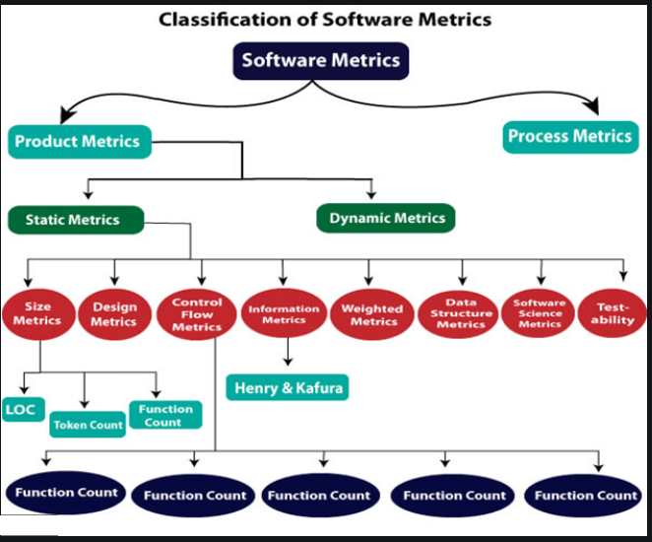

Slide 76
What is Security Engineering
It is a process of adding and implementing security controls into the IT infrastructure including the information system to make the former an integral part of the organization’s operational capabilities.
Security engineers build systems that have the ability to protect their assets from attack. Using threat analysis, you can determine the controls required to reduce the exposure that results when attacks exploit system vulnerabilities.
Security is an essential prerequisite for software quality factors such as integrity, availability, reliability, and safety.

Slide 77
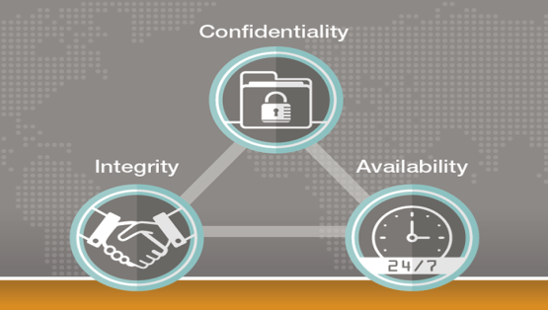
Why is Security Engineering important?
Each emerging technology brings new concerns about user privacy and the potential loss or theft of valuable information.
Security is not just a concern to the people developing software for the military, government, or health agencies.
Today, security must be the concern of every software engineer who has client resources to protect.
confidentiality, Integrity and Availability, also known CIA triad, is a model designed to guide policies for information security within an organization.

Slide 78
Analyzing Security Requirements
Requirements for software security are determined by working with the customer to identify the assets that must be protected and the cost associated with the loss of those assets should a security breach occur.
The value of the loss of an asset is known as its exposure. Losses might be measured in time or cost to recover or recreate an asset.

Slide 79
An important part of building secure systems is anticipating conditions or threats that may be used to damage system resources or render them inaccessible to authorized users. This process is called threat analysis.
Once the system assets, vulnerabilities, and threats have been identified, controls can be created to either avoid attacks or mitigate their damage.
Software security is an essential prerequisite for software integrity, availability, reliability, and safety.
It may not be possible to create a system that can defend its assets against all possible threats, and for that reason, it may be necessary to encourage users to maintain backup copies of critical data, redundant system components, and ensure privacy controls are in place.

Slide 80
Security & Privacy in an Online World
Internet activity is moving away from traditional desktop browsing and toward scenarios in which browsers provide dynamic, customized content.
Users can enter their own content on community forums that incorporate data mash-ups from third-party sites.
Many desktop applications make use of web browser interfaces to access local data and provide a uniform user experience on multiple computing platforms.
In many instances a user’s confidential information flows across organizational boundaries on the Internet.

Slide 81
Social Media
The explosive growth and popularity of online social media networks have made them attractive targets for malicious programmers. Because of the implicit trust most users have in a social network environment, it is easy for a hacker to use a compromised account to send malware-infected messages to the account holder’s friends.

Slide 82
Mobile Applications
Users of mobile apps have access to almost the same web services that fixed-location wired Internet users have. Wireless Internet users have inherited all the security risks associated with desktop commerce, plus many new risks unique to mobile networks.
The platforms and languages developed for mobile devices can be hacked, and malicious code can be inserted into the device system software with all the privileges of the device owner.
This means that security technologies such as sign-in, authentication, and encryption can be undermined with relative ease.

Slide 83
Cloud Computing
Cloud computing brings additional confidentiality and privacy concerns because data is entrusted to remote servers that are managed by service providers. These cloud service providers have complete access and control over our data. They are trusted not to share it with others and to take responsible steps to prevent its loss.

Slide 84
Internet of Things
Some visionaries describe an “Internet of Things” in which everything real has a virtual counterpart on the Internet. These virtual entities can produce and consume services and collaborate toward a common goal. For example, automotive engineers envision cars that communicate autonomously with other vehicles, data sources, and devices and do not require direct driver control.
However, security is one of the major obstacles that stand in the way of this vision. Without strong security foundations, attacks and malfunctions will outweigh any of the benefits realized by IoT

